Slide 1

RailVisionNet : Smart Railway Track Crack Detection Using Computer Vision,YOLOv12,U-Net++ DSA0204 - Computer Vision with OpenCV
GUIDED BY:
Dr. G.A.Senthil SIMATS ENGINEERING
CHENNAI
PRESENTED BY:
V.Sri Sadhvik(192424289). K.Sampath Reddy(192424295).
G.Kushwanth (192424150).

Slide 2

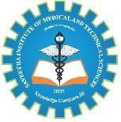
Introduction
Railway transportation is one of the safest and most widely used modes of transport worldwide.
Railway tracks continuously experience heavy loads, weather effects, and material fatigue.
Small cracks can gradually grow into major defects, leading to derailments and accidents.
Traditional manual inspections are slow, labor-intensive, expensive, and prone to human error.
Artificial Intelligence and Computer Vision enable automated, faster, and more accurate inspections.
RailVisionNet combines YOLOv12 for defect detection and U-Net++ for precise crack segmentation.
The proposed system supports real-time monitoring and predictive railway maintenance.

Slide 3
Literature survey
Author(s) & Year | Title | Methodology / Techniques Used | Key Findings | Research Gap
Li et al. (2024) | Railway Surface Defect Detection Using YOLO-Based Deep Learning | YOLO object detection, Computer Vision, CNN | Achieved high-speed railway defect detection with improved accuracy and real-time performance. | Pixel-level crack segmentation and severity analysis were not included.
Zou et al. (2023) | Deep Learning-Based Railway Track Inspection Using Computer Vision | CNN, Image Processing, Feature Extraction | Automated railway inspection reduced manual effort and improved detection accuracy. | Limited performance under poor lighting and adverse weather conditions.
Wang et al. (2023) | Railway Crack Segmentation Using U-Net++ | U-Net++, Semantic Segmentation, Data Augmentation | U-Net++ produced accurate crack boundary segmentation with high IoU scores. | Real-time object detection and integrated monitoring systems were not implemented.
Kumar et al. (2024) | AI-Based Predictive Maintenance for Railway Infrastructure | Deep Learning, IoT Sensors, Predictive Analytics | AI enabled early fault detection and optimized maintenance scheduling. | Focused mainly on sensor data rather than image-based crack detection.

Slide 4
Problem statement
Railway track inspection mainly depends on manual visual inspections.
Minor cracks are often difficult to identify during routine inspections.
Delayed crack detection increases maintenance costs and safety risks.
Existing inspection methods require specialized vehicles and skilled personnel.
Environmental conditions such as rain, dust, and poor lighting reduce inspection accuracy.
Lack of continuous monitoring may result in unexpected railway failures.
There is a need for an intelligent, automated, and real-time crack detection system.

Slide 5

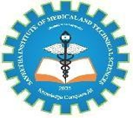

Objectives
Develop an AI-based railway crack detection system.
Automatically identify railway track defects from images and videos.
Detect cracks accurately using YOLOv12.
Perform pixel-level crack segmentation using U-Net++.
Analyze crack severity for maintenance prioritization.
Generate automatic alerts for railway authorities.
Improve railway safety while reducing inspection time and operational costs.

Slide 6
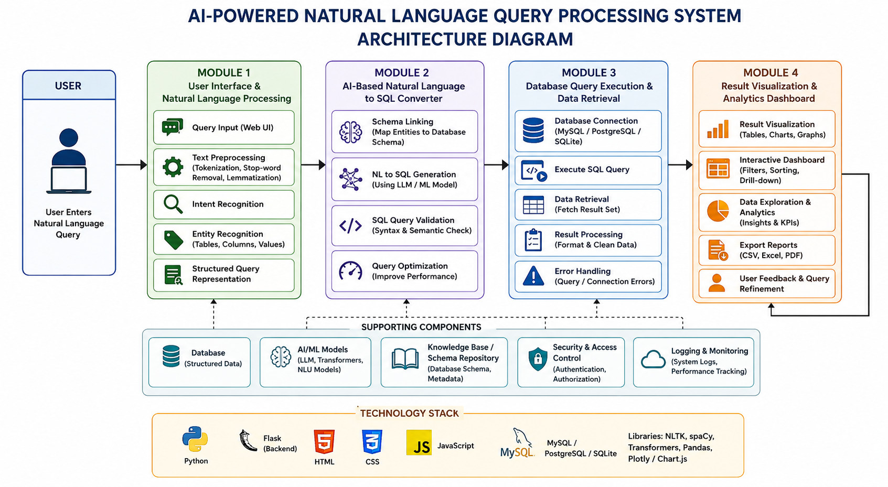
Architecture diagram

Slide 7


Module 01:Railway Track Image Acquisition & Preprocessing
Capture images using drones, inspection vehicles, CCTV cameras, or mobile devices.
Collect high-resolution images under various weather and lighting conditions.
Remove image noise using Gaussian and Median filtering techniques.
Enhance image quality through histogram equalization and contrast adjustment.
Resize and normalize images for deep learning model compatibility.
Perform data augmentation (rotation, flipping, brightness adjustment) to improve model robustness.
Prepare clean and standardized datasets for model training.

Slide 8
Module 02:Crack Detection & Segmentation
YOLOv12 detects cracks and localizes damaged regions in real time.
Bounding boxes identify the exact crack location.
U-Net++ performs detailed pixel-level segmentation of crack areas.
Measure crack length, width, and affected surface area.
Classify cracks based on severity (Minor, Moderate, Severe).
Filter false detections using confidence thresholds.
Generate highly accurate defect maps for maintenance planning.

Slide 9
Module 03: Alert & Monitoring System
Store detected crack information in a centralized database.
Generate instant maintenance alerts for critical defects.
Display crack locations on an interactive monitoring dashboard.
Integrate GPS coordinates for accurate defect localization.
Prioritize repairs based on crack severity levels.
Maintain historical inspection records for predictive maintenance.
Support remote monitoring through cloud-based platforms.

Slide 10
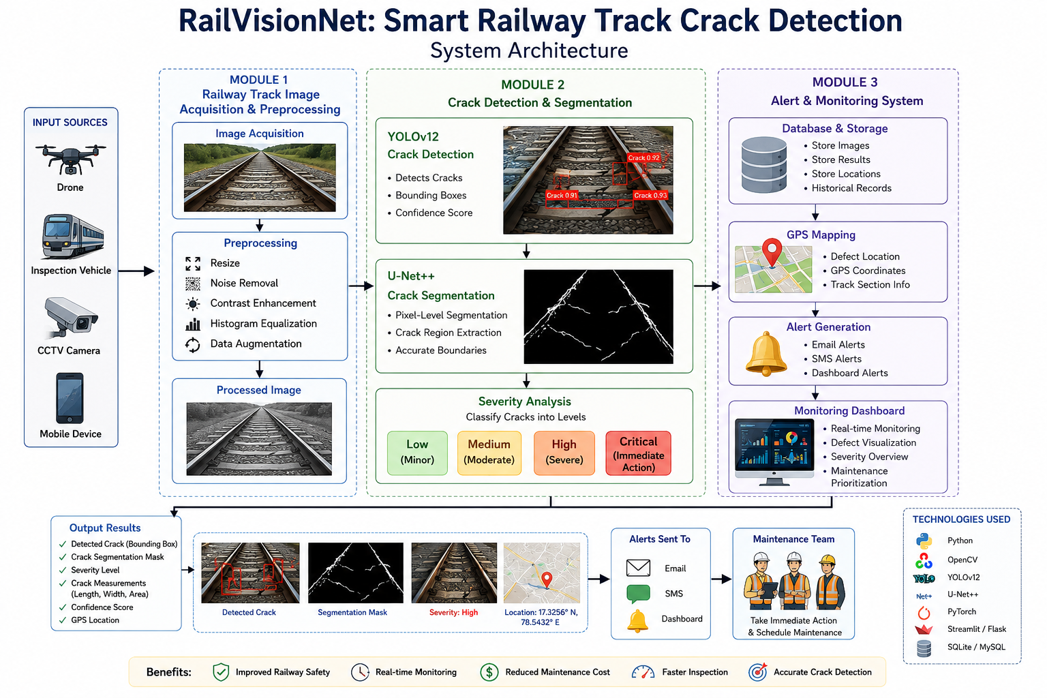
Architecture Diagram

Slide 11
Results
Detect railway cracks with high precision and accuracy.
Achieve real-time defect detection from images and videos.
Produce detailed segmentation masks for crack regions.
Reduce manual inspection efforts significantly.
Improve maintenance planning using severity analysis.
Enable continuous railway infrastructure monitoring.
Enhance railway operational safety.

Slide 12
Output

Slide 13
Conclusion
RailVisionNet provides an intelligent solution for railway crack detection.
YOLOv12 enables fast and accurate real-time defect detection.
U-Net++ improves crack localization through precise segmentation.
Automated alerts support timely maintenance decisions.
AI-based monitoring enhances railway infrastructure reliability.
The proposed system reduces accidents caused by undetected track defects.
It contributes to building safer and smarter railway transportation systems.

Slide 14
References
Zou, Q., Zhang, Z., Li, Q., et al. (2023). Deep Learning-Based Railway Track Inspection Using Computer Vision. IEEE Access.
Li, Y., Wang, H., & Chen, X. (2024). Rail Surface Defect Detection Using YOLO-Based Deep Neural Networks. Expert Systems with Applications.
IEEE Transactions on Intelligent Transportation Systems (2023). Automated Railway Track Defect Detection Using Deep Learning.
MDPI Sensors (2024). Computer Vision-Based Crack Detection for Smart Railway Infrastructure.
Network Rail (UK) – AI Track Inspection Programme (2023–2024).
Indian Railways – Artificial Intelligence for Track Inspection & Predictive Maintenance (2024–2025).
Deutsche Bahn (Germany) – AI-Powered Railway Infrastructure Monitoring (2023–2024).

Slide 15


Slide 16
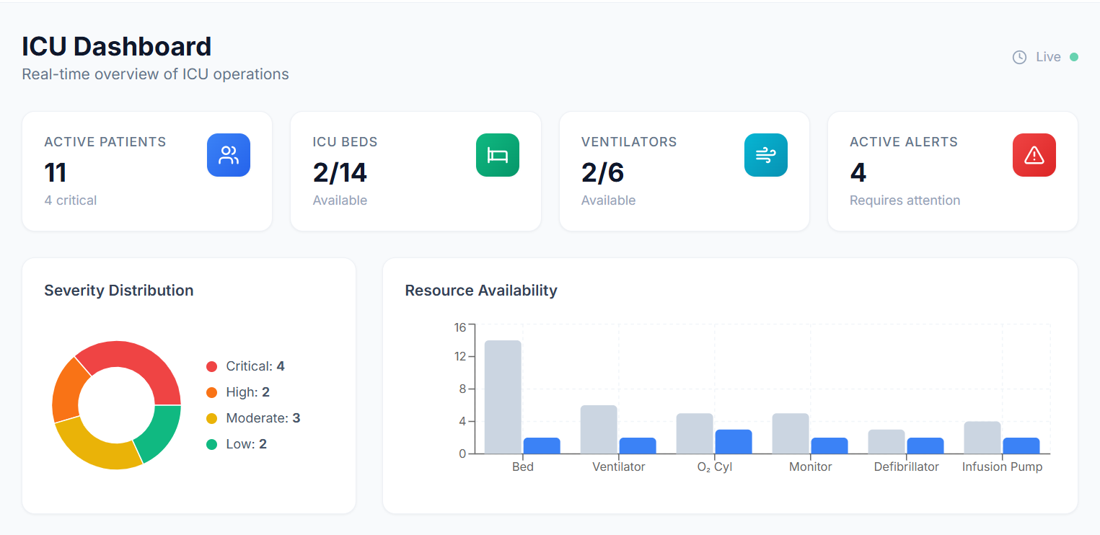
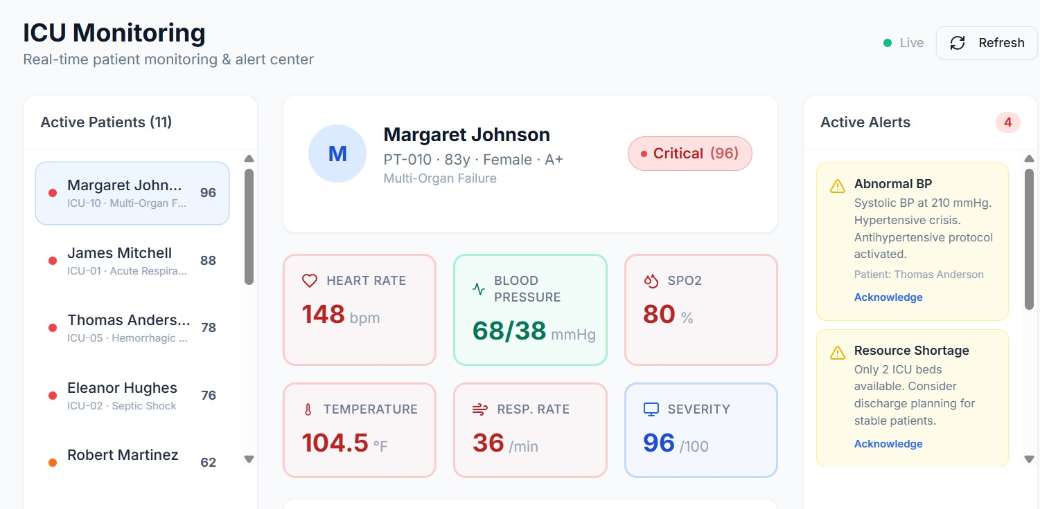
Implementation

Slide 17
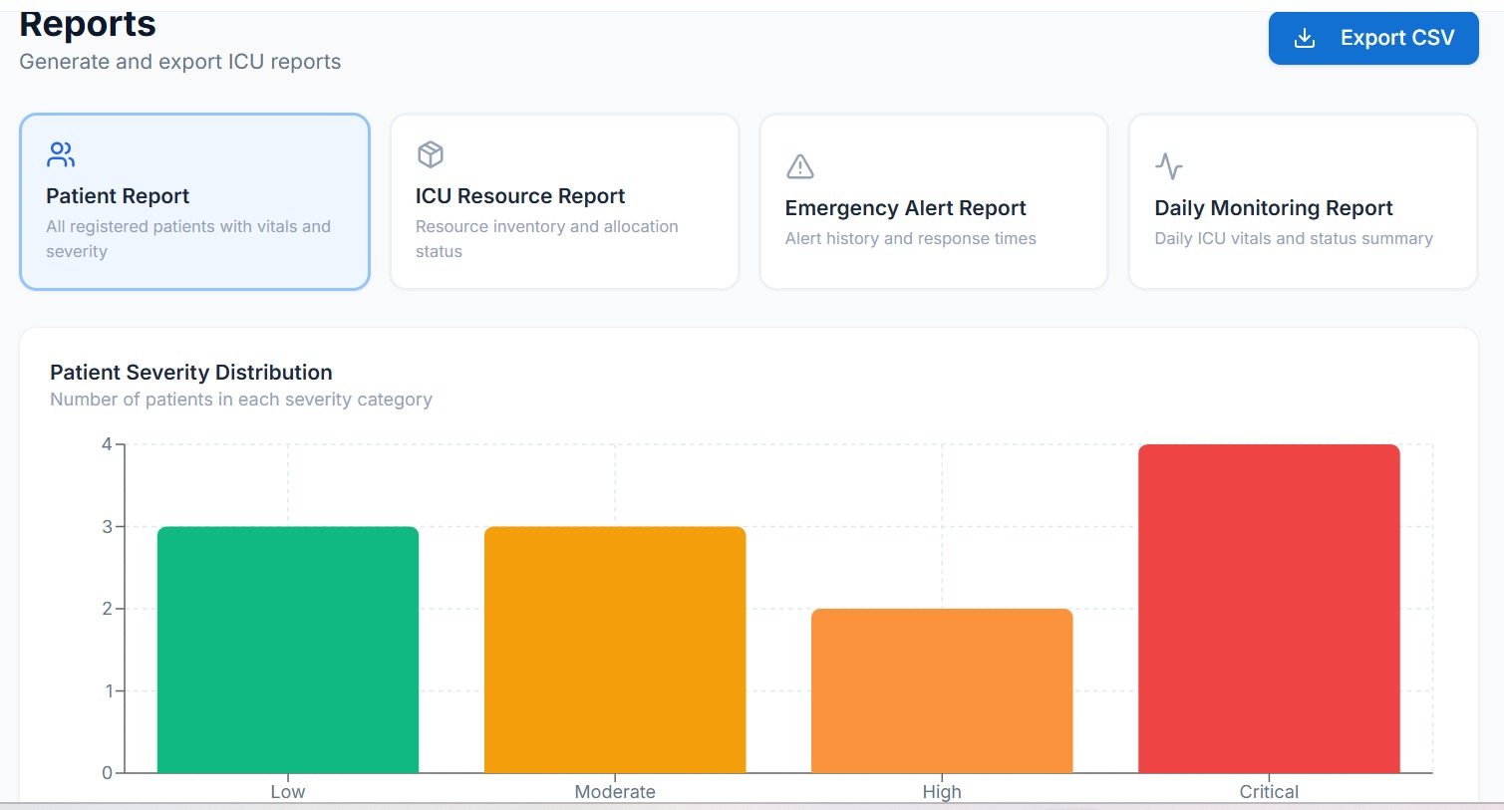
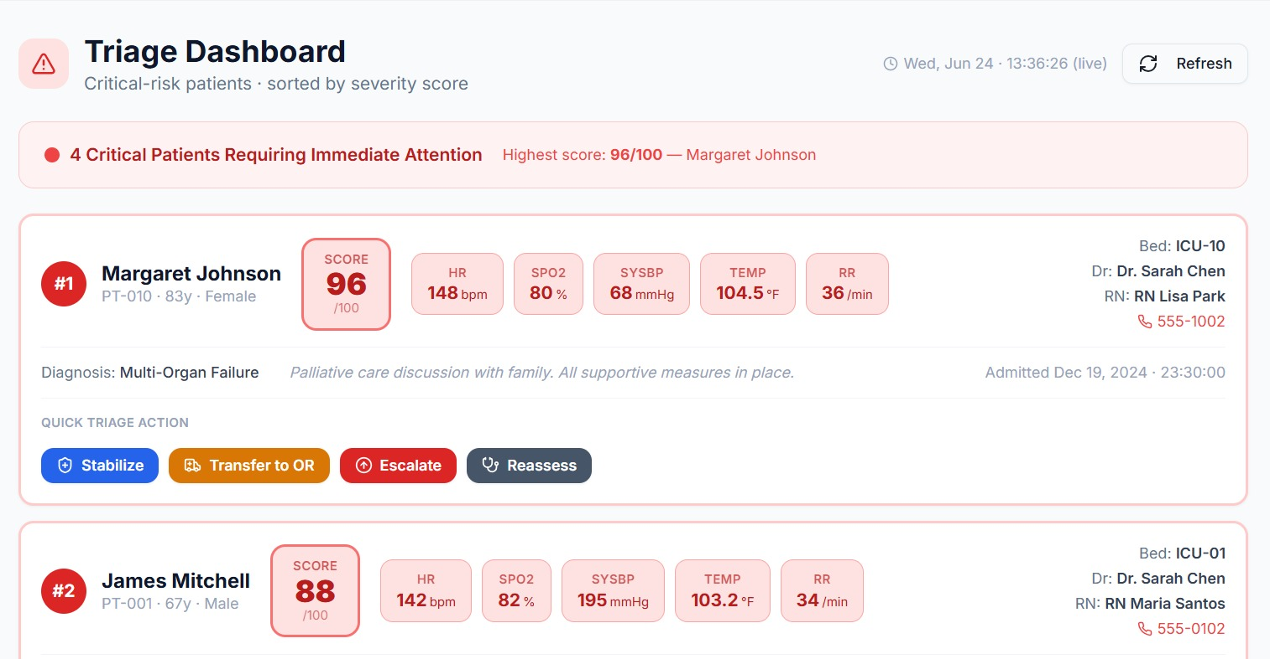

Slide 18
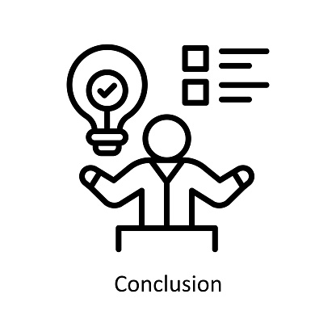
Conclusion
The proposed platform enables real-time monitoring and assessment of ICU patient conditions.
Machine Learning algorithms help predict patient severity and support accurate prioritization of critical care resources.
Dynamic resource allocation optimizes the utilization of ICU beds, medical equipment, and healthcare staff.
Intelligent clinical decision support assists healthcare professionals in making timely and informed treatment decisions.
The integrated framework improves patient outcomes, reduces resource wastage, and enhances the overall efficiency of critical healthcare services.

Slide 19
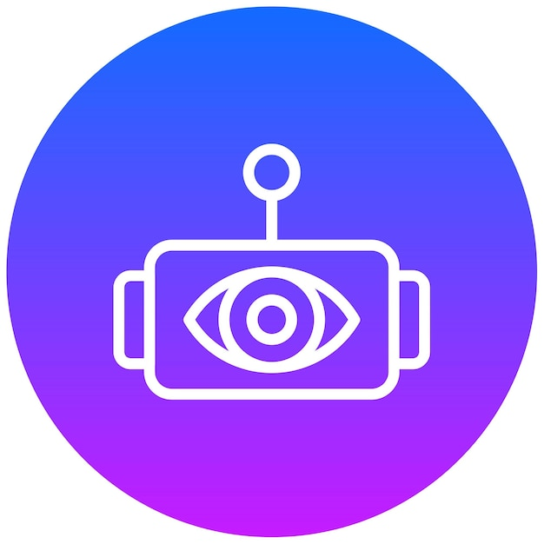
Future scope
Integrate advanced AI and Deep Learning algorithms to improve the accuracy of patient severity prediction and clinical decision-making.
Incorporate IoT-enabled medical devices for continuous real-time monitoring of patient vital signs.
Extend the platform across multiple hospitals to enable regional resource sharing and coordinated critical care management.
Develop mobile and cloud-based applications for remote monitoring and access by healthcare professionals.
Implement predictive analytics for outbreak and emergency preparedness to optimize resource planning and improve healthcare response capabilities.

